Slide 1

THE dIGITAL WALLET OF BANGLADESH
Name : Md. Saikot Anam
Department: Chemistry
Batch no: 39
Id no : 01-039-03

Slide 2
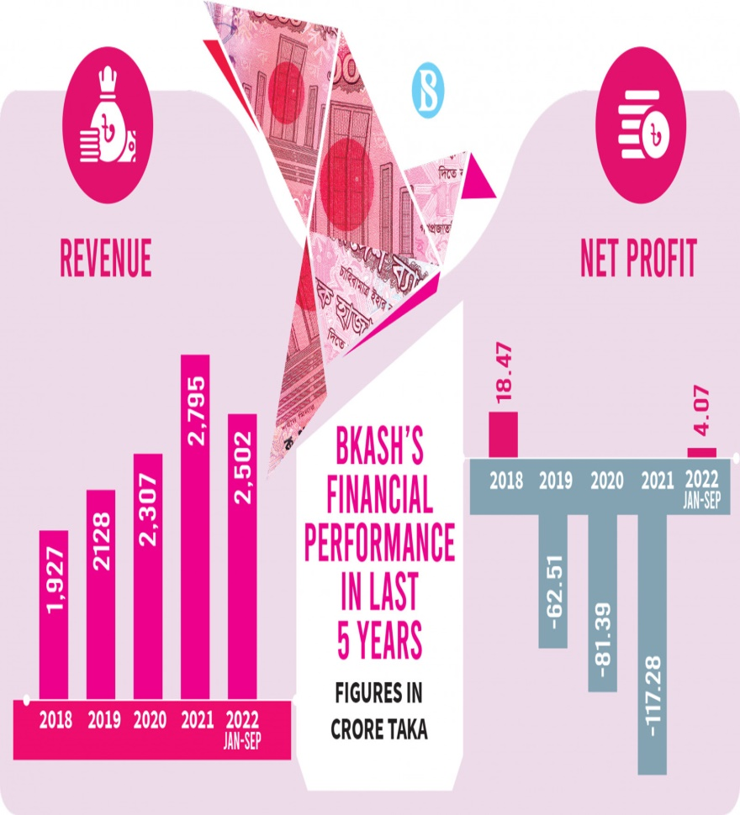
INTRODUCTION
bKash is a mobile financial service launched in 2011 by BRAC Bank in Bangladesh . It allows users to conduct financial transactions easily through their mobile phones.
To enhance financial inclusion and improve the living standards of people in Bangladesh by providing accessible financial services.
Over 50 million registered users as of 2023, showcasing its extensive reach and acceptance.

Slide 3

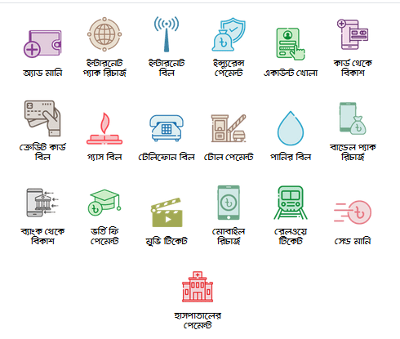



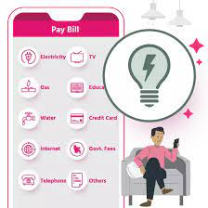
PRODUCT & SERVICES
Mobile wallet
Money Transfer
Bill payment
Savings
Cash management
b
International Remittance
Merchant Paments
insurance Service
.

Slide 4
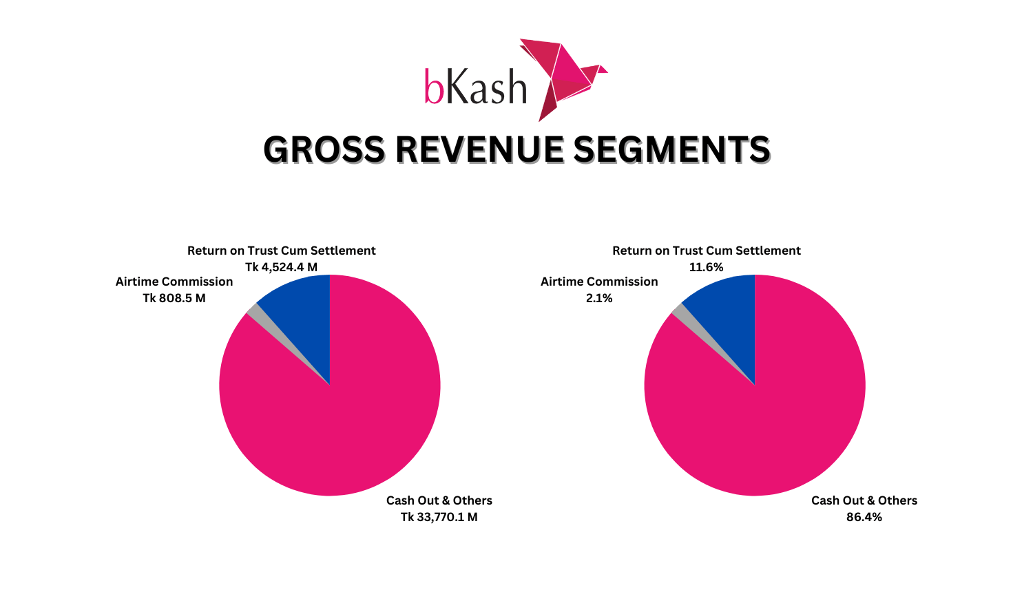
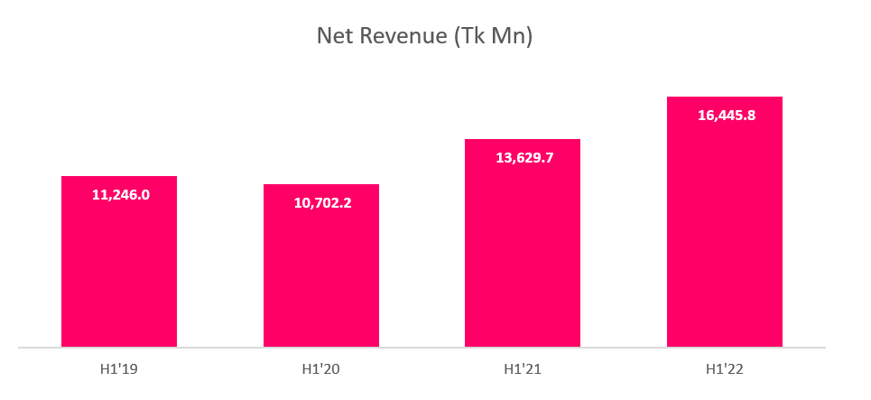
Growth Trajectory
bKash has seen exponential growth since its launch, becoming the largest mobile financial service in Bangladesh . Supported over 10 billion transactions since its inception.
Economic Impact: Promotes economic activity by facilitating easy access to money transfer services . Significant contributor to financial inclusion, especially in rural areas .
Financial Literacy : Offers educational programs to improve financial literacy among users, ensuring they understand the benefits of digital transactions.

Slide 5
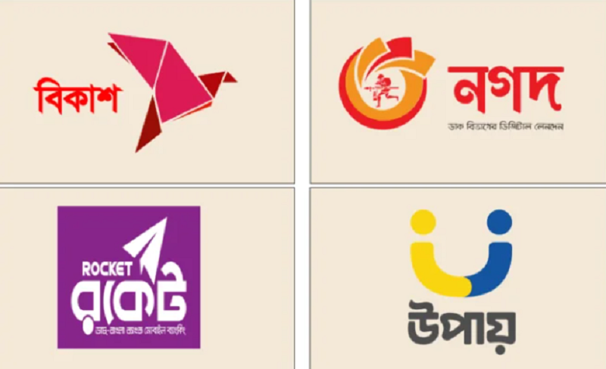
Challenges Faced by bKash
1. Competition:
Increasing competition from other mobile financial services (e.g., Nagad, Rocket).
2. Regulatory Challenges : Adhering to changing regulations from the Bangladesh Bank and government.
3. Security Concerns : Addressing concerns over fraud and cyber threats.
4. User Adoption : Encouraging less tech-savvy users to adopt digital transactions.

Slide 6
Future Outlook:
Growth Potential: bKash is positioned for robust growth, leveraging the rising adoption of digital payments in Bangladesh as smartphone usage and internet access expand.
Service Diversification: The company plans to broaden its offerings beyond money transfers, exploring microloans and insurance to meet the diverse needs of its customer base
Strategic Partnerships: Collaborations with banks and fintech firms are expected to strengthen bKash's competitive advantage, solidifying its leadership in the digital finance sector
Regulatory Support: With increasing government focus on financial inclusion, bKash is likely to benefit from supportive regulations that promote digital finance and enhance user trust.
Technological Innovation: Investing in cutting-edge technology, such as AI and blockchain, will enable bKash to improve service efficiency and security, further attracting a broader customer base.

Slide 7
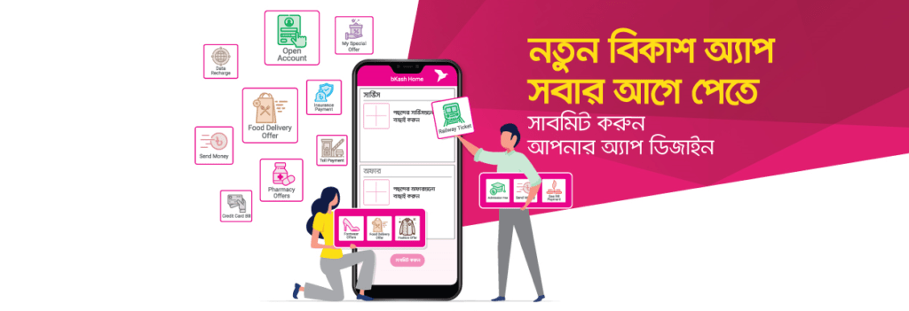
THANK YOU

